Slide 1
EXAM 1 REVIEW
Database Concepts
Spring 2021
Week 8

Slide 2
Scope & Format
Scope: Chs. 1-4
Test-taking: via Canvas (open-book)
Date/Location: March 02; take-home
Due: March 02 @1:00pm
Available: March 02 from 12:01am - 1:00pm
Time: 75 minutes
Number of questions: 50 multiple-choice questions
Access code:

Slide 3
Chapter 1. Database Systems

Slide 4
Data vs. Information
Data
Raw facts
Raw data - Not yet been processed to reveal the meaning
Building blocks of information
Information
Produced by processing data
Reveals the meaning of data
Enables knowledge creation
Should be accurate, relevant, and timely to enable good decision making

Slide 5
What do databases store?
A database stores a collection of:
End-user data - Raw facts of interest to end user
Metadata: Data about data, which the end-user data are integrated and managed
Describe data characteristics and relationships

Slide 6
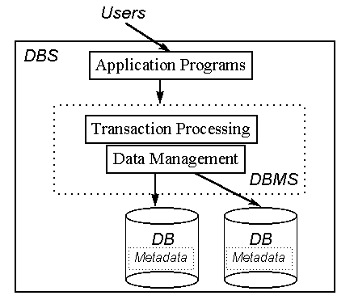
Database Systems
Source: http://holowczak.com/wp-content/uploads/db_arch.png
Five components of database systems
Hardware, Software, People, Procedure, and Data
Notes:
Software: Operating system, DBMS software, Application programs and utility software

Slide 7
Database Management System (DBMS)
Collection of programs
Manages the database structure
Controls access to data stored in the database
Response of the DBMS to a query is the query result set

Slide 8
Advantages of the DBMS
Improved:
▪▪ Data sharing
▪▪ Data security
▪▪ Data integration
▪▪ Minimized data inconsistency
▪▪ Data access
▪▪ End-user productivity

Slide 9
Types of databases
Classified by (pp.9-10) (*review textbook)
the number of users supported
a single-user/a desktop/a workgroup/an enterprise database
where the data are located
a centralized/a distributed/a cloud database
the type of data stored
general-purpose/discipline-specific databases
the intended data usage
an operational (transactional)/analytical database
the degree to which the data are structured
unstructured/structured databases
Notes:
A(n) ? database is used by an organization and supports many users across many departments.
A(n) ? database is designed to support a company’s day-to-day operations.

Slide 10
Data Redundancy
▪▪ Unnecessarily storing same data at different places
▪▪ Islands of information: Scattered data locations
▪▪ Increases the probability of having different versions of the same data

Slide 11
Data Redundancy Implications
Poor data security
Data inconsistency
Increased likelihood of data-entry errors when complex entries are made in different files
Data anomaly: Develops when not all of the required changes in the redundant data are made successfully

Slide 12
Chapter 2. Data Models

Slide 13
Data Model Basic Building Blocks
Entity (Table)
Unique and distinct object used to collect and store data
e.g.) person, place, thing, event, concept
Attribute (Field)
Characteristic of an entity
Equivalent of a field in a file system
Relationship
Describes an association among entities
One-to-many (1:M)
Many-to-many (M:N or M:M)
One-to-one (1:1)
Constraint
Set of rules to ensure data integrity
Restriction placed on the data

Slide 14
Primary Key and Foreign Key
A primary key (PK) is an attribute or combination of attributes that uniquely identifies any given row.
In some ER diagrams, PKs are indicated by underlining
A foreign key (FK) is the primary key of one table that has been placed into another table to create a common attribute.

Slide 15
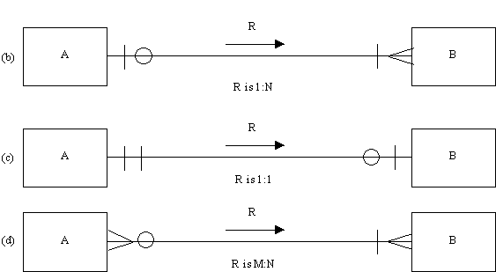
Relationship Type
minimum # of instances of one entity that can be
associated with the entity on the opposite
maximum # of instances of one entity that can be
associated with the entity on the opposite

Slide 16



Business Rules
Brief, precise, and unambiguous description of a policy, procedure, or principle
Enable defining the basic building blocks
Serve as a communication tool between the users and designers

Slide 17
Translating Business Rules into Data Model Components
Nouns translate into entities
Verbs translate into relationships among entities
Relationships are bidirectional
Questions to identify the degree of relationship type
How many instances of B are related to one instance of A?
How many instances of A are related to one instance of B?

Slide 18
Relational Model
Based on a relation
Relation or table: Matrix composed of intersecting tuple and attribute
Tuple: Rows
Attribute: Columns
Describes a precise set of data manipulation constructs

Slide 19
Relational Database Management System (RDBMS)
Performs basic functions provided by the hierarchical and network DBMS systems
Makes the relational data model easier to understand and implement
Hides the complexities of the relational model from the user

Slide 20
NoSQL Databases
▪▪ Not based on the relational model
▪▪ Support distributed database architectures
▪▪ Provide high scalability, high availability, and fault tolerance
▪▪ Support large amounts of sparse data
▪▪ Geared toward performance rather than transaction consistency
▪▪ Store data in key-value stores

Slide 21
Chapter 3. The Relational Database Model

Slide 22
A Logical View of Data
Relational database model enables logical representation of the data and its relationships
Logical simplicity yields simple and effective database design methodologies
Facilitated by the creation of data relationships based on a logical construct called a relation

Slide 23
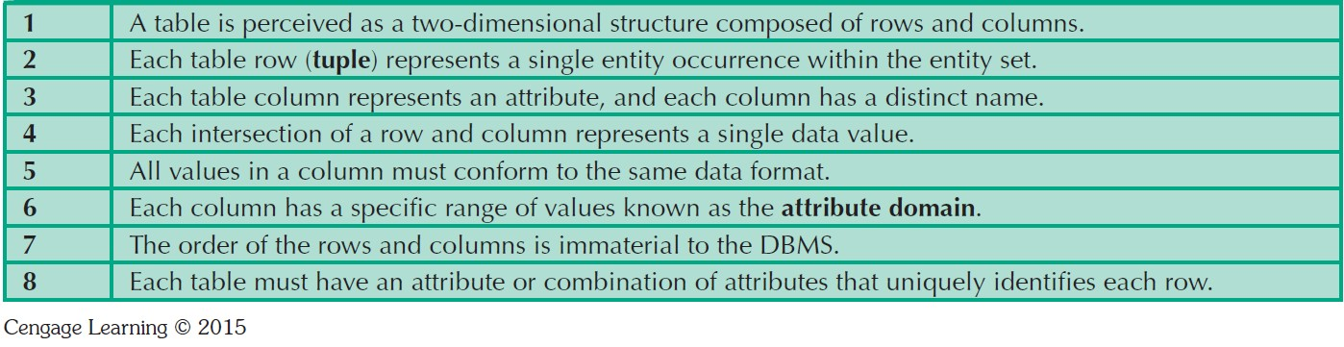
Table 3.1 - Characteristics of a Relational Table

Slide 24
Determination
State in which knowing the value of one attribute makes it possible to determine the value of another
Is the basis for establishing the role of a key
Based on the relationships among the attributes
Notes:
If you know the value of attribute A, you can look up the value of attribute B.

Slide 25
Dependencies
Functional dependence: Value of one or more attributes determines the value of one or more other attributes
Determinant: Attribute whose value determines another
Dependent: Attribute whose value is determined by the other attribute
Full functional dependence: Entire collection of attributes in the determinant is necessary for the relationship
Notes:
The attribute B is functionally dependent on the attribute A if each value in column A determines one and only one value in column B.

Slide 26
Types of Keys
Key: an attribute or group of attributes that can determine the values of other attributes
Prime attribute: any attribute that is part of a key
Composite key: a key that is composed of more than one attribute
▪▪ Null: Absence of any data value (No data entry at all) that could represent:
▪▪ An unknown attribute value
▪▪ A known, but missing, attribute value
▪▪ An inapplicable condition

Slide 27
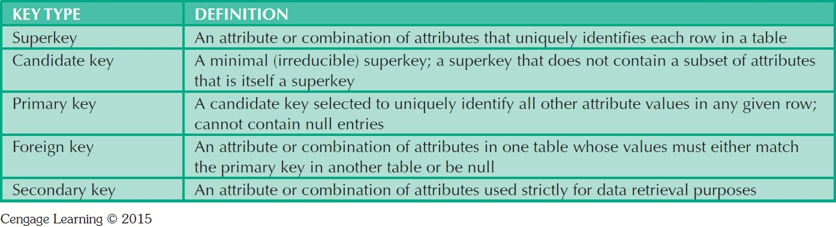
Table 3.3 - Relational Database Keys
Notes:
http://dba.stackexchange.com/questions/71924/what-is-the-difference-between-primary-key-and-super-key-in-dbms

Slide 28
Integrity (Database Design) Rules
Entity integrity: Condition in which each row in the table has its own unique identity
Every table must have a primary key.
A primary key cannot contain be NULL.
Referential integrity: Mechanism the system provides to maintain foreign keys
A foreign key must have matching values in the primary key of another table.

Slide 29
Relational Operators
SELECT (RESTRICT): A unary operator -- list all of the rows, or yield only rows that match a specified criterion.
PROJECT: A unary operator – yield all values for selected attributes.
UNION: yields all rows from two tables, excluding duplicate rows.
Union-compatible: both tables must have the same number of attributes (columns) and corresponding attributes (columns) must have the same domain.
INTERSECT: yield only the rows that appear in both tables.
DIFFERENCE: yield all rows in one table that are not found in the other table.

Slide 30
Relational Operators
PRODUCT: yields all possible pairs of rows from two tables.
DIVIDE: uses one 2-column table as the dividend and one single-column as the divisor. DEVIDE yields a single column that contains all values from the second column of the dividend that are associated with every row in the divisor.
INNER JOIN: only returns matched records from the tables that are being joined
OUTER JOIN: matched pairs are retained and unmatched values in the other table are left null

Slide 31
Chapter 4. Entity Relationship Modeling

Slide 32
Entity Relationship Model (ERM)
Basis of an entity relationship diagram (ERD)
ERD depicts the:
Conceptual database as viewed by end user
Database’s main components
Entities
Attributes
Relationships
Entity - Refers to the entity set and not to a single entity occurrence

Slide 33
Attributes
Required attribute
Must have a value, cannot be left empty
Optional attribute
Does not require a value, can be left empty
Domain
Set of possible values for a given attribute
Identifiers (Primary keys)
One or more attributes that uniquely identify each entity instance

Slide 34
Attributes
Composite identifier
Primary key composed of more than one attribute
Composite attribute
Attribute that can be subdivided to yield additional attributes
e.g.) Address, Phone number
Simple attribute
Attribute that cannot be subdivided
e.g.) Age, gender, marital status
Single-valued attribute
Attribute that has only a single value
e.g.) SSN, a part’s serial number
Multivalued attributes (*You should not implement them in RDBS)
Attributes that have many values
e.g.) degrees, a car’s color

Slide 35
Attributes
Multivalued attributes: Attributes that have many values and require creating:
Create several new attributes, one for each component of the original multivalued attribute (*can cause structural problems)
A new entity composed of the original multivalued attribute’s components
Derived attribute: Attribute whose value is calculated from other attributes
Indicated in the Chen model by a dashed line
e.g.) employee’s age: INT(DATE()-EMP_DOB/365),
total cost of order: Multiplying the quantity ordered by the unit price

Slide 36
Relationships
Association between entities that always operate in both directions
Participants: Entities that participate in a relationship
Connectivity: Describes the relationship classification
Cardinality: Expresses the minimum and maximum number of entity occurrences associated with one occurrence of related entity

Slide 37


Relationship Strength
Weak (non-identifying) relationships
Primary key of the related entity does not contain a primary key component of the parent entity
Strong (identifying) relationships
Exists when the PK of a child entity contains at least part of its primary key from a parent entity.
Depicted as a solid line in a Crow’s Foot

Slide 38


Existence Dependence
Existence dependence
Entity exists in the database only when it is associated with another related entity occurrence
Existence independence
Entity exists apart from all of its related entities
Referred to as a strong entity or regular entity

Slide 39
Weak Entity
Conditions
The entity must be existence-dependent on its parent entity.
The entity must inherit at least part of its primary key from its parent entity.

